Slide 1
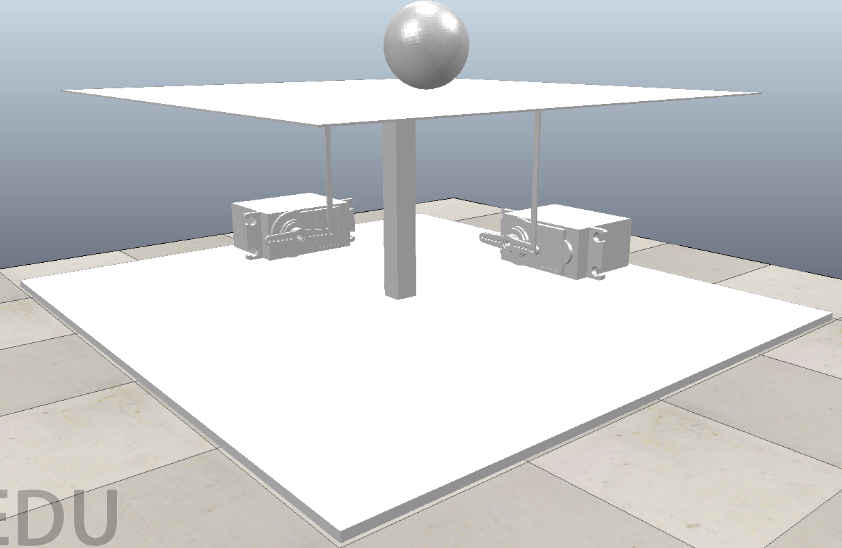
Ball and Plate
Group:
Nicholas Chenevey
Janette Calvillo Solis
Joseph Mount
Jason Fry
Jonathan Okokwo

Slide 2
Project Description
A controller for a ball and plate system was designed using Matlab, Simulink and Coppelia. The system had to keep a ball balanced at the center of the plate and must react according to the ball’s position to prevent the ball from falling off the plate.

Slide 3
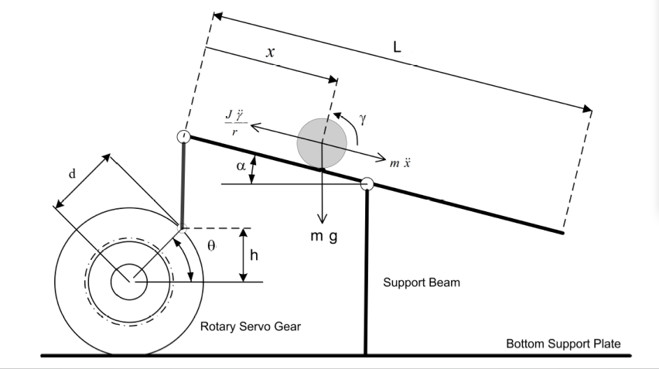
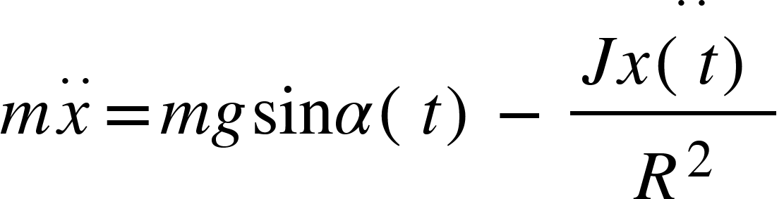
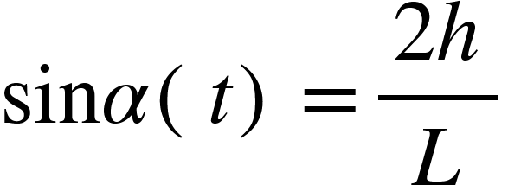
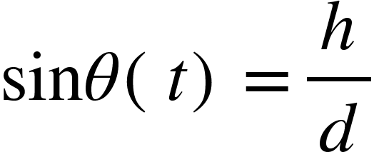
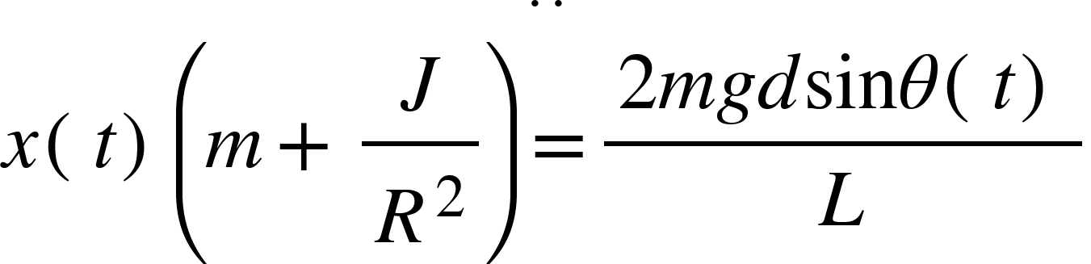
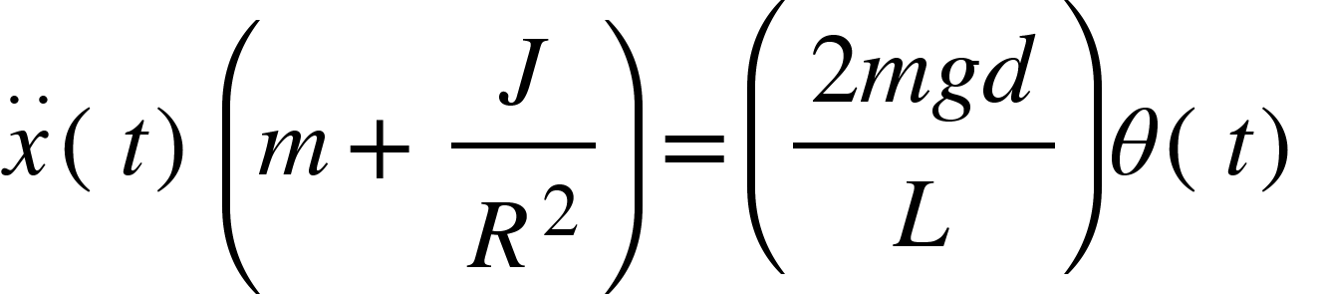
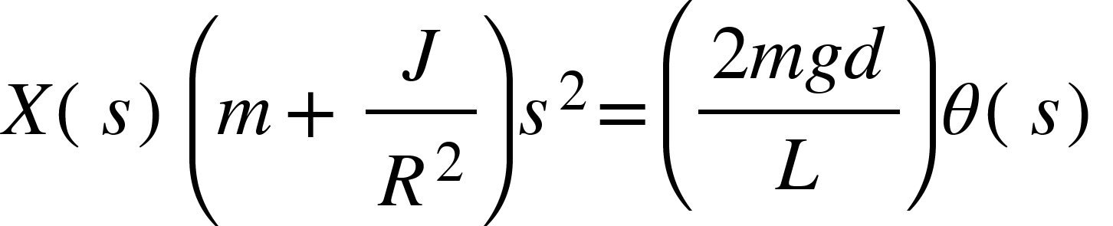
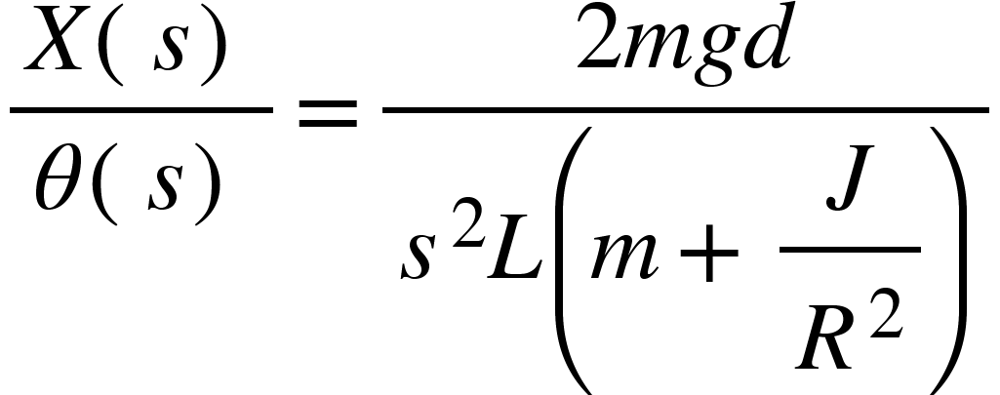
Modeling
Equations:

Slide 4
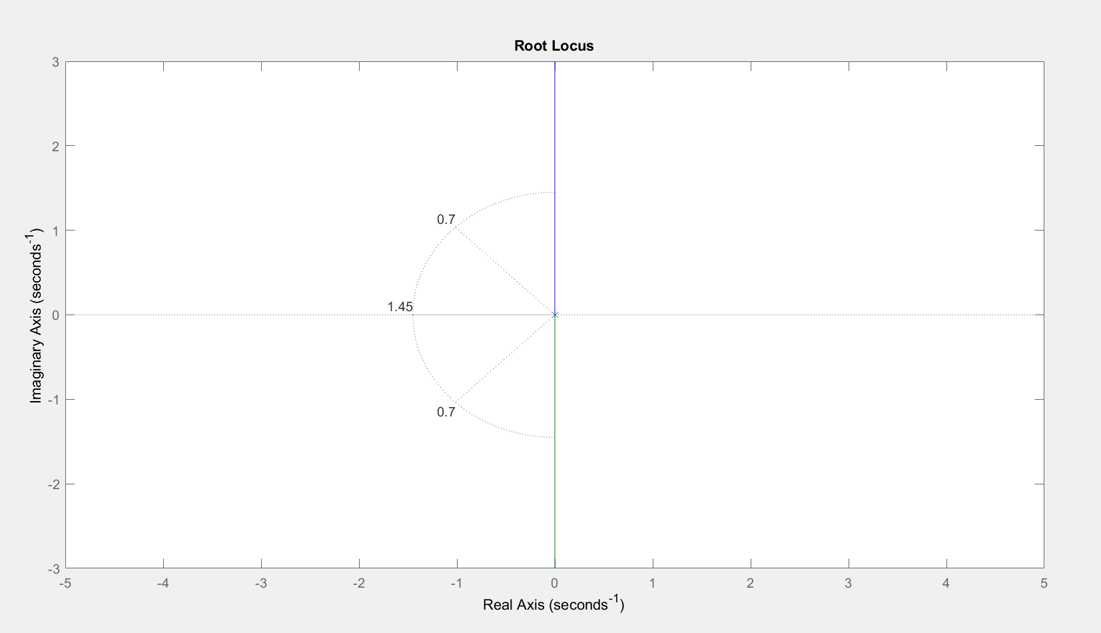
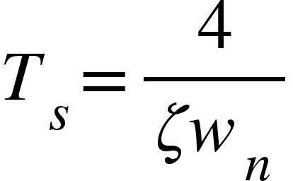
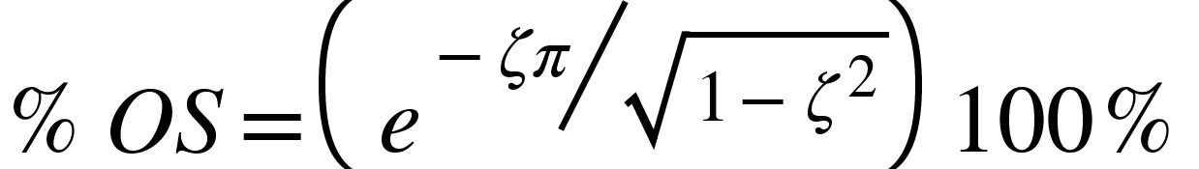
Root Locus

Slide 5
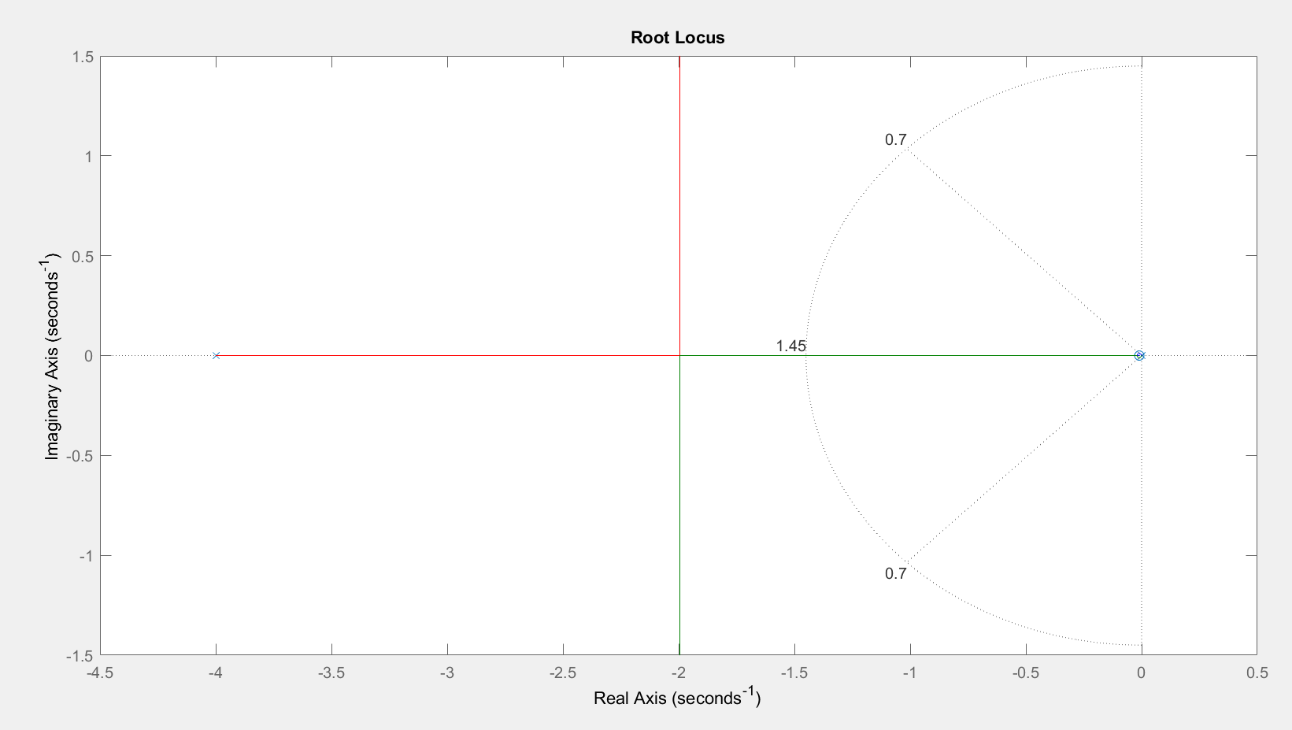
Lead Controller
Poles:
0.01
4

Slide 6
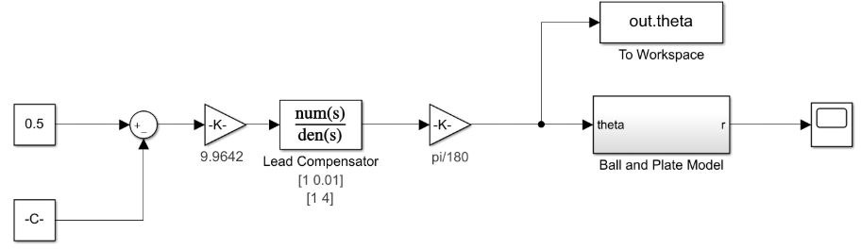
Simulink Model Used Before Coppelia

Slide 7
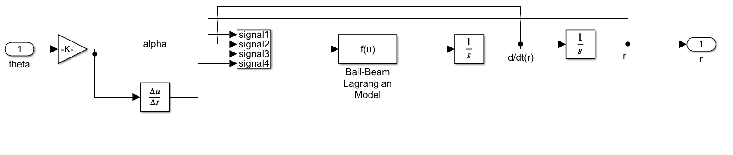
Ball and Beam Simulink Model

Slide 8
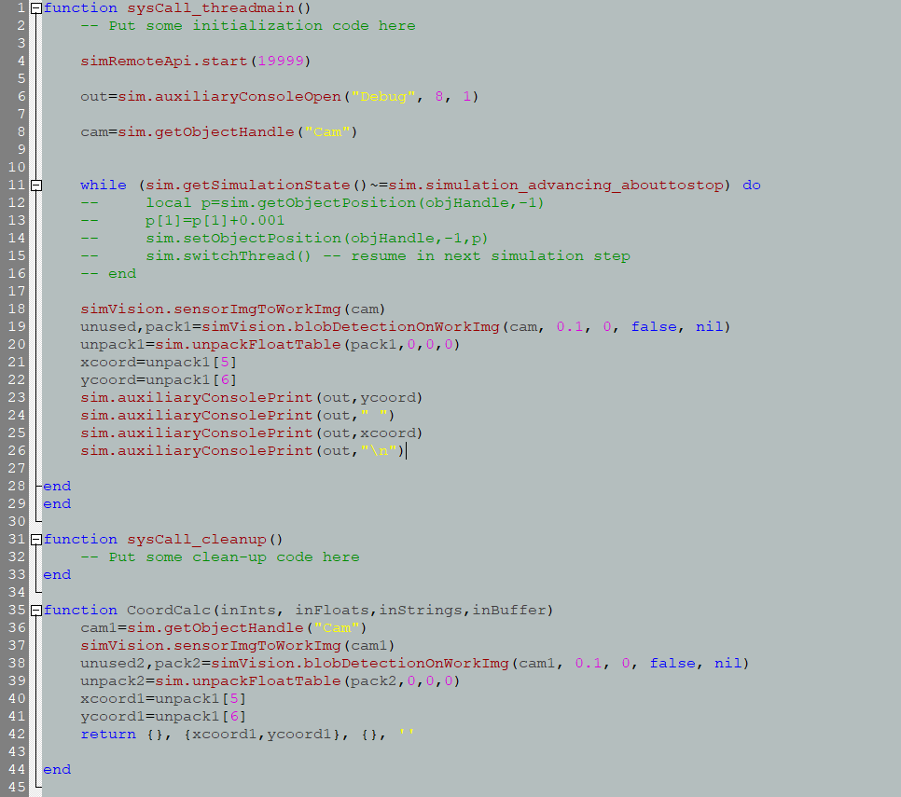
Coppelia’s Code to Communicate with Matlab

Slide 9
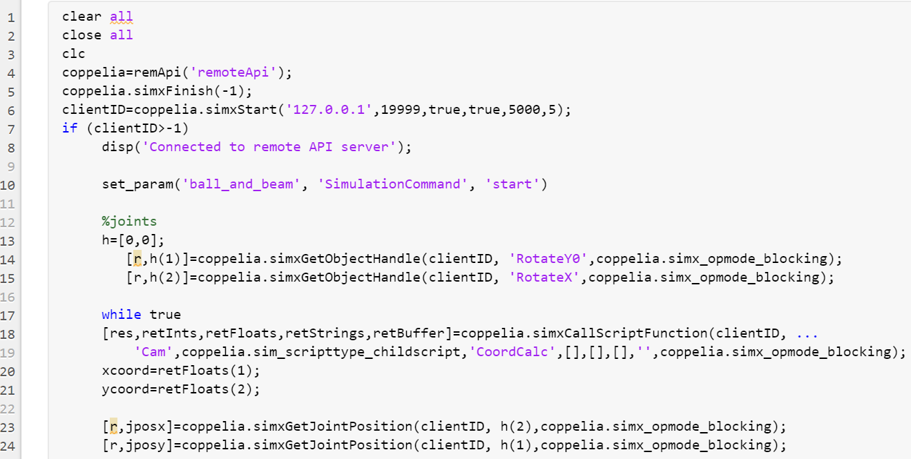
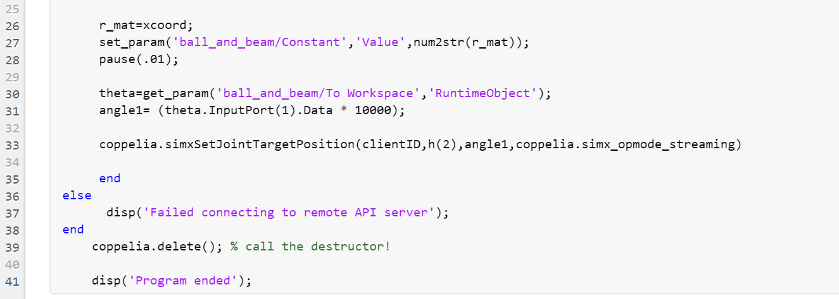
Matlab Code to Communicate with Coppelia

Slide 10
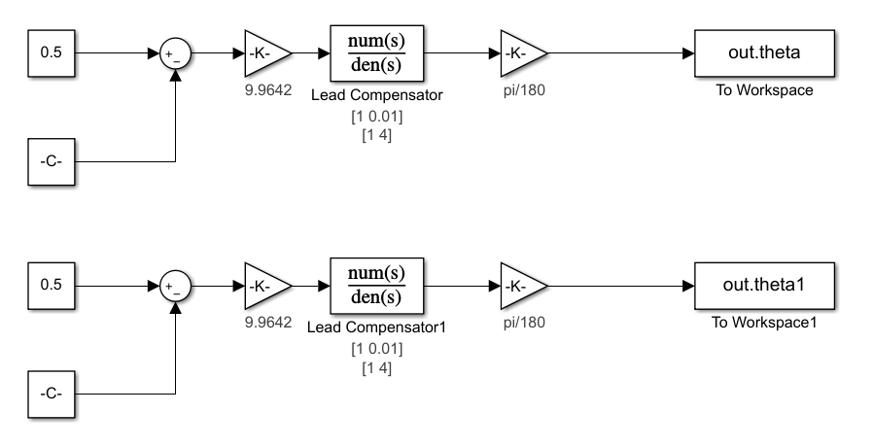
Simulink Model Used With Coppelia

Slide 11

Coppelia Simulation Using Simulink and Matlab

